Slide 2
Presentation on URDU NASAR Presented by
DR. Sabiha Sayyad From Night College of Arts and Commerce ,Ichalkarnaji. Urdu Department

Slide 4
VIDEO LINK

Slide 6
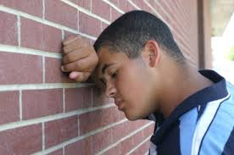
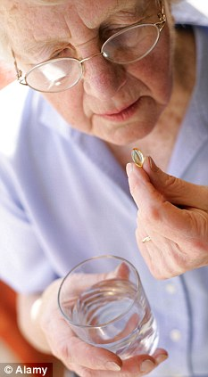

Slide 7
Thank You

